Slide 1
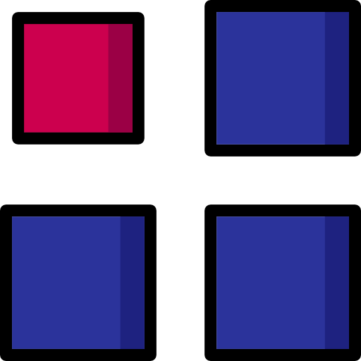
Arrays

Slide 2

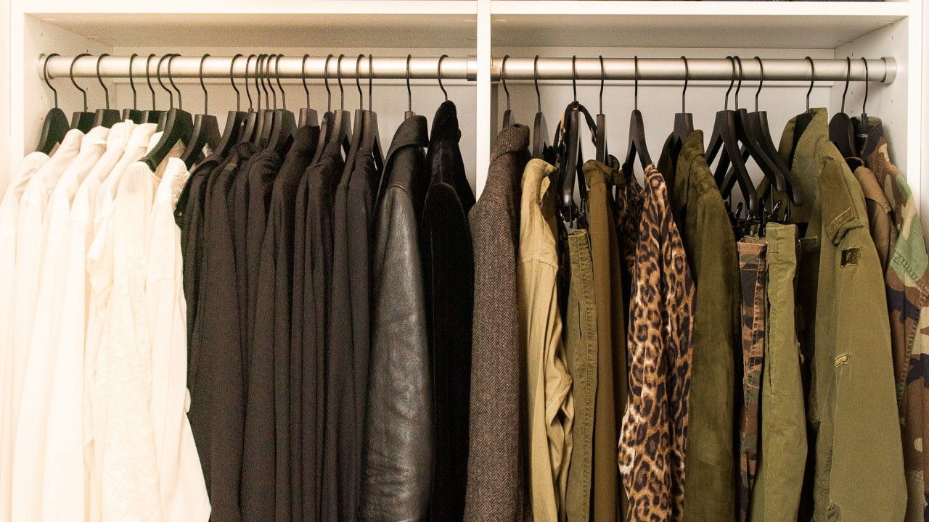
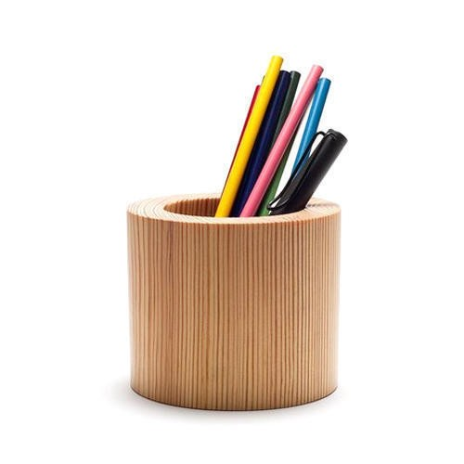
Arrays

Slide 3
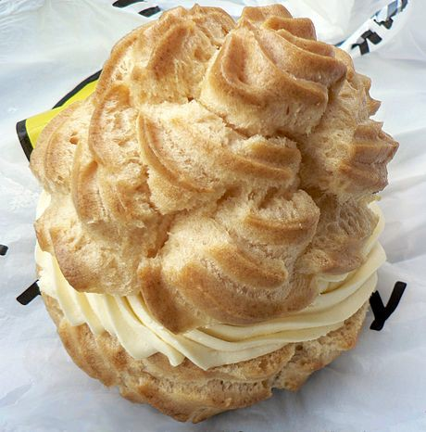
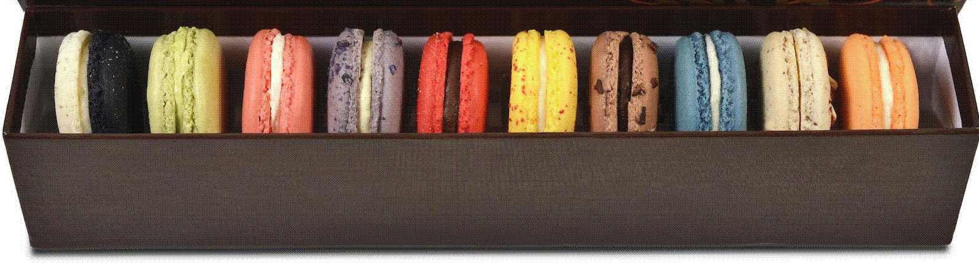
Arrays
It is a box of macaroons.
All macaroons in this box are next to each other
Each macaroon can be identified uniquely based on their location
The size of box cannot be changed
“a”
4 | 3 | 1 | 6 | 8 | 10
[0] [1] [2] [3] [4] [5]
Array can store data of specified type
Elements of an array are located in a contiguous
Each element of an array has a unique index
The size of an array is predefined and cannot be modified

Slide 4
What is an Array?
In computer science, an array is a data structure consisting of a collection of elements , each identified by at least one array index or key. An array is stored such that the position of each element can be computed from its index by a mathematical formula.
4 | 3 | 1 | 6 | 8 | 10
[0]
[1] [2]
[3]
[4]
[5]
Why do we need an Array?
3 variables
What if 500 integer?
Are we going to use 500 variables?
number1 number2 number3
The answer is an ARRAY

Slide 5

Types of Arrays

Slide 6
Types of Arrays
Arrays
One Dimensional
Multi dimensional
Two dimensional
Three dimensional
Four dimensional
.
.
N dimensional

Slide 7




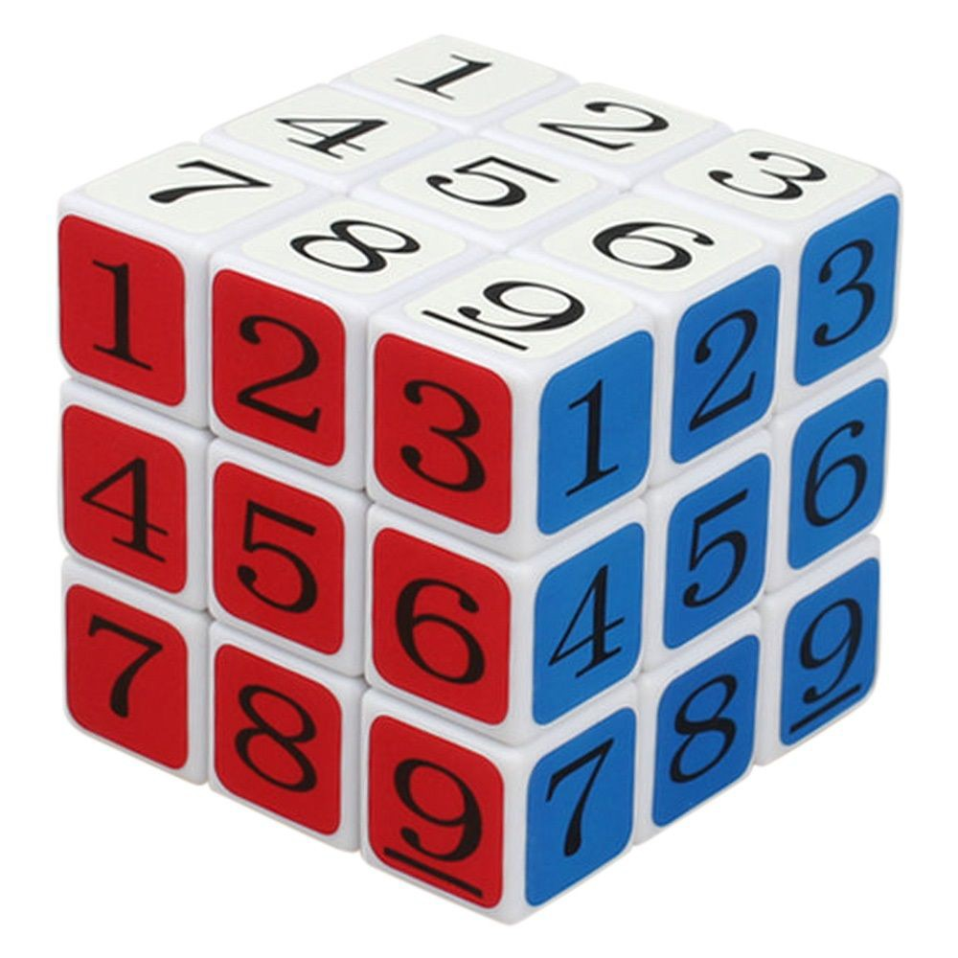
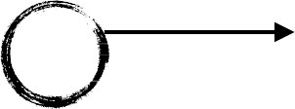

Types of Arrays
One dimensional array : an array with a bunch of values having been declared with a single index.
a[i] —> i between 0 and n a[2] a[5]
5 | 4 | 10 | 11 | 8 | 11 | 68 | 87 | 12
[0] [1] [2] [3] [4] [5] [6] [7] [8]
Two dimensional array : an array with a bunch of values having been declared with double index.
a[i][j] —> i and j between 0 and n
[0] [1] [2] [3]
a[0][4]
[4] [5]
a[2][5]
[6] [7] [8]
[0]
[1]
[2]
Three dimensional array : an array with a bunch of values having been declared with triple index.
a[i][j][k] —> i , j and k between 0 and n
a[2][0][2]
a[0][0][1]
1 | 33 | 55 | 91 | 20 | 51 | 62 | 74 | 13
5 | 4 | 10 | 11 | 8 | 11 | 68 | 87 | 12
24 | 50 | 37 | 40 | 48 | 30 | 59 | 81 | 93

Slide 8
Types of Arrays
One dimensional array :
5 | 4 | 10 | 11 | 8 | 11 | 68 | 87 | 12
Two dimensional array :
1 | 33 | 55 | 91 | 20 | 51 | 62 | 74 | 13
5 | 4 | 10 | 11 | 8 | 11 | 68 | 87 | 12
24 | 50 | 37 | 40 | 48 | 30 | 59 | 81 | 93
Three dimensional array :

Slide 9

Arrays in Memory

Slide 10
Arrays in Memory
One Dimensional
5 | 4 | 10 | 11 | 8 | 11 | 68 | 87 | 12
Memory
 |  | 5 | 4 | 10 | 11 | 8 | 11 | 68 | 87 | 12

Slide 11
Arrays in Memory
Two Dimensional array
1 | 2 | 3
4 | 5 | 6
7 | 8 | 9
Memory
 |  |  | Row 1 |  |  |  |  |  |  | Ro | w 3
 |  | 1 | 2 |  | 3 | 4 | 5 |  | 6 | 7 | 8 |  | 9
 |  |  |  |  |  |  | Row 2

Slide 12
Arrays in Memory
Three Dimensional array
{{{ | 0, | 1, | 2},
{ | 3, | 4, | 5},
{ | 6, | 7, | 8},
{ | 9, | 10, | 11},
{ | 12, | 13, | 14},
{ | 15, | 16, | 17}}};
Memory
 |  |  | 0 | 1 |  | 2 |  | 3 |  | 4 | 5 | 6 |  | 7 |  | 8 |  | 9 | 10 | 11 |  | 12 |  | 13 | 14 | 15 |  | 16 |  | 17

Slide 13
Creating an Array
When we create an array , we:
Declare - creates a reference to array
Instantiation of an array - creates an array
Initialization - assigns values to cells in array
Memory
 |  | arr

Slide 14
Creating an Array
When we create an array , we:
Declare - creates a reference to array
Instantiation of an array - creates an array
Initialization - assigns values to cells in array
Memory
 |  |  |  |  |  | xx11+0 | xx11+1 | xx11+2
 |  |  |  |  |  | 0 | 0 | 0 | 0 | 0
 |  |  |  |  |  | xx11
 |  | xx11
 |  | arr

Slide 15
Creating an Array
When we create an array , we:
Declare - creates a reference to array
Instantiation of an array - creates an array
Initialization - assigns values to cells in array
Memory
 |  |  |  |  |  | xx11+0 | xx11+1 | xx11+2
 |  |  |  |  |  | 10 | 10 | 10 | 10 | 10
 |  |  |  |  |  | xx11
 |  | xx11
 |  | arr

Slide 16
Creating an Array
When we create an array , we:
Declare - creates a reference to array
Instantiation of an array - creates an array
Initialization - assigns values to cells in array
dataType[] arr
arr = new dataType[]
arr[0] | = | 1
arr[1] | = | 2

Slide 17
Insertion in Array
“a” | “b” |  | “c” |  | “d” |  |  | “f”
[0] | [1] | [2] |  | [3] |  | [4] |  | [5]
myArray =
myArray[3] = “d”
myArray[5] = “f”

Slide 18
Insertion in Array
“f”
“a” | “b” |  | “c” |  | “d” |  | “e”
[0] | [1] | [2] |  | [3] |  | [4] |  | [5]

Slide 19
Insertion in Array
“f”
“a” | “b” |  | “c” |  | “d” |  | “e”
[0] | [1] | [2] |  | [3] |  | [4] |  | [5]
“f” “a” “b” “c” “d” “e”
[0] [1] [2] [3] [4] [5]

Slide 20



Insertion in Array
Wait A minute! What Happens if the Array is Full?
“f”
FULL
“a” “b” “c” “d” “e” “h”
[0] [1] [2] [3] [4] [5]

Slide 21
Insertion in Array
Insertion , when an array is full.
“a” | “b” |  | “c” |  | “d” |  | “e” |  | “h”
[0] | [1] | [2] |  | [3] |  | [4] |  | [5]
“a” | “b” | “c” | “d” | “e” | “h”
[0] | [1] | [2] | [3] | [4] | [5] | [6] | [7] | [8] | [9] |  | [10] |  | [11] |  | [12]

Slide 22
Array Traversal
“a” | “b” |  | “c” |  | “d” |  | “e” |  | “f”
[0] | [1] | [2] |  | [3] |  | [4] |  | [5]
myArray =
myArray[0] = “a” myArray[1] = “b” myArray[2] = “c” myArray[3] = “d” myArray[4] = “e” myArray[5] = “f”

Slide 23
Accessing Array Element
Memory
 |  |  |  |  |  | xx11+0 | xx11+1 | xx11+2
 |  |  |  |  |  | 1 | 2 | 3 | 4 | 5
 |  |  |  |  |  | xx11
 |  | xx11
 |  | arr

Slide 24
Accessing Array Element
INDEX
[0] [1] [2] [3] [4] [5]
<arrayName>[index]

Slide 25
Accessing Array Element
For example:
myArray =
“a” | “b” |  | “c” |  | “d” |  | “e” |  | “f”
[0] | [1] | [2] |  | [3] |  | [4] |  | [5]
myArray[0] = “a”
myArray[3] = “d”

Slide 26
Finding Array Element
“a” | “b” |  | “c” |  | “d” | “e” |  | “h”
[0] | [1] | [2] |  | [3] |  | [4] | [5]
myArray =
8
9
6
7
4
5
myArray2 =
2
3
1

Slide 27
Finding Array Element
Is this the element?
“a” | “b” |  | “c” |  | “d” |  | “e” |  | “h”
[0] | [1] | [2] |  | [3] |  | [4] |  | [5]

Slide 28
Deleting Array Element
Integer.MIN_VALUE
10 | 20 |  | ₋₂31 |  | 40 |  | ₋₂31 |  | ₋₂31
[0] | [1] | [2] |  | [3] |  | [4] |  | [5]
30

Slide 29
Time and Space Complexity of 1D Arrays
Operation | Time complexity | Space complexity
Creating an empty array | O(1) | O(n)
Inserting a value in an array | O(1) | O(1)
Traversing a given array | O(n) | O(1)
Accessing a given cell | O(1) | O(1)
Searching a given value | O(n) | O(1)
Deleting a given value | O(1) | O(1)

Slide 30
Find Number of Days Above Average Temperature
How many day's temperature?
2
Day 1’s high temp:
1
Day 2’s high temp:
2
Output
Average = 1.5
1 day(s) above average

Slide 31


Two Dimensional Array
An array with a bunch of values having been declared with double index.
a[i][j] —> i and j between 0 and n
a[0][4]
[1] [2] [3] [4] [5]
a[2][5]
[6] [7] [8]
[0]
[0]
[1]
[2]
1 | 33 | 55 | 91 | 20 | 51 | 62 | 74 | 13
5 | 4 | 10 | 11 | 8 | 11 | 68 | 87 | 12
24 | 50 | 37 | 40 | 48 | 30 | 59 | 81 | 93
Day 1 - 11, 15, 10, 6
Day 2 - 10, 14, 11, 5
Day 3 - 12, 17, 12, 8
Day 4 - 15, 18, 14, 9

Slide 32
Two Dimensional Array
When we create an array , we:
Declare - creates a reference to array
Instantiation of an array - creates an array
Initialization - assigns values to cells in array
Memory
10 | 20 | 30
40 | 50 | 60
 |  |  |  |  |  | xx11+0 | xx11+1 | xx11+2
 |  |  |  |  |  | 10 | 20 | 30 | 40 | 50 | 60
 |  |  |  |  |  | xx11
 |  | xx11
 |  | arr
0
0
0
0
0
0

Slide 33
Insertion - Two Dimensional Array
[0] [1] [2] [3] [4] [5] [6] [7] [8]
[0]
[1]
[2]
50
 |  |  |  |  | 30
arrayName[2][5] = 30
arrayName[0][0] = 50
arrayName[0][0] = 60
Occupied

Slide 34


Access an element of Two Dimensional Array
a[i][j] —> i is row index and j is column index
a[2][5]
a[0][4]
[0] [1] [2] [3] [4] [5] [6] [7] [8]
[0]
[1]
[2]
1 | 33 | 55 | 91 | 20 | 51 | 62 | 74 | 13
5 | 4 | 10 | 11 | 8 | 11 | 68 | 87 | 12
24 | 50 | 37 | 40 | 48 | 30 | 59 | 81 | 93

Slide 35
Traversing Two Dimensional Array
1 | 33 | 55 | 91
5 | 4 | 10 | 11
24 | 50 | 37 | 40
1 33 55 91 5 4 10 11 24 50 37 40

Slide 36
Searching Two Dimensional Array
Is this the element?
1 | 33 | 55 | 91
5 | 4 | 44 | 11
24 | 50 | 37 | 40
Searching for 44
The element is found at [1][2]

Slide 37
Deleting Array Element in 2D Array
[0]
[1]
[2]
[3]
[0]
[1]
[2]
1 | 33 | 55 | 91
5 | ₋₂31 | 10 | 11
24 | 50 | 37 | ₋₂31
4
40
arrayName[2][3] = Integer.MIN_VALUE
arrayName[1][1] = Integer.MIN_VALUE

Slide 38
Time and Space Complexity of 2D Array
Operation | Time complexity | Space complexity
Creating an empty array | O(1) | O(mn)
Inserting a value in an array | O(1) | O(1)
Traversing a given array | O(mn) | O(1)
Accessing a given cell | O(1) | O(1)
Searching a given value | O(mn) | O(1)
Deleting a given value | O(1) | O(1)

Slide 39
When to use/avoid Arrays
When to use
To store multiple variables of same data type
Random access
When to avoid
Same data type elements
Reserve memory

Slide 40
When to use/avoid Arrays
When to use
To store multiple variables of same data type
Random access
When to avoid
Same data type elements
Reserve memory

Slide 41

Array Project

Slide 42
Array Project
Find Number of Days Above Average Temperature
How many day's temperature?
2
Day 1’s high temp:
1
Day 2’s high temp:
2
Output
Average = 1.5
1 day(s) above average

Slide 43

Array Interview Questions

Slide 44
Missing Number
Find the missing number in an integer array of 1 to 100
1,2,3,4,5,6…50,51,52..100
1,2,3,4,5,6,7,8,9,10 = 55
1,2,3,4,5,6,8,9,10 = 48
7
1,2,3,4,5,6…n = n(n+1)/2

Slide 45
Pairs / Two Sum
Write a program to find all pairs of integers whose sum is equal to a given number.
[2, 6, 3, 9, 11] 9 [6,3]

Slide 46
Pairs / Two Sum
Write a program to find all pairs of integers whose sum is equal to a given number.
[2, 6, 3, 9, 11] 9 [6,3]
Does array contain only positive or negative numbers?
What if the same pair repeats twice, should we print it every time?
If the reverse of the pair is acceptable e.g. can we print both (4,1) and (1,4) if the given sum is 5.
Do we need to print only distinct pairs? does (3, 3) is a valid pair forgiven sum of 6?
How big is the array?

Slide 47
Search for a Value
Write a program to to check if an array contains a number in Java
Searching for 40
Found at the index of 4
Is this the element?
20 | 10 |  | 30 |  | 50 |  | 40 |  | 60
[0] | [1] | [2] |  | [3] |  | [4] |  | [5]

Slide 48
Max Product of Two Integers
Write a program to find maximum product of two integers in the array where all elements are positive
maxProduct = 0
20 | 10 |  | 30 |  | 50 |  | 40 |  | 60
[0] | [1] | [2] |  | [3] |  | [4] |  | [5]

Slide 49
Is Unique
Write a program to check if an array is unique or not.
isUnique
True
20 | 10 |  | 30 |  | 50 |  | 40 |  | 60
[0] | [1] | [2] |  | [3] |  | [4] |  | [5]

Slide 50
Permutation
Your are given two integer arrays. Write a program to check if they are permutation of each other.
Permutation
True
2 | 1 | 3 | 5 | 4 | 6
1 | 3 | 2 | 4 | 6 | 5
sum1 = 21
sum2 = 21
mul1 = 720
mul2 = 720

Slide 51


Rotate Matrix
Given an image represented by an NxN matrix write a method to rotate the image by 90 degrees.
1 | 2 | 3
4 | 5 | 6
7 | 8 | 9
7 | 2 | 1
4 | 5 | 6
9 | 8 | 3
7 | 4 | 1
8 | 5 | 2
9 | 6 | 3
for i = 0 to n temp = top[i] top[i] = left[i]
left[i] = bottom[i] bottom[i] = right[i] right[i] = temp

